Slide 1
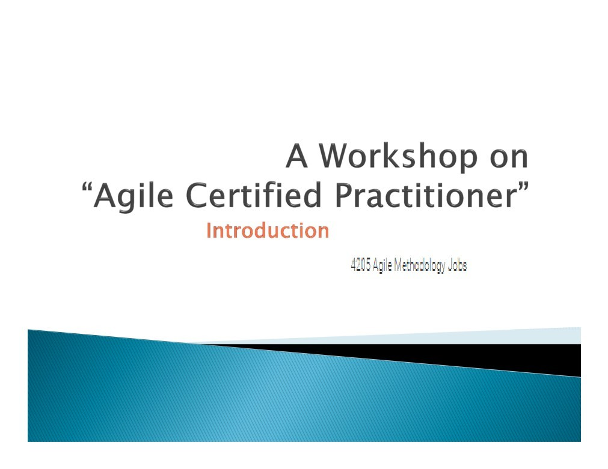
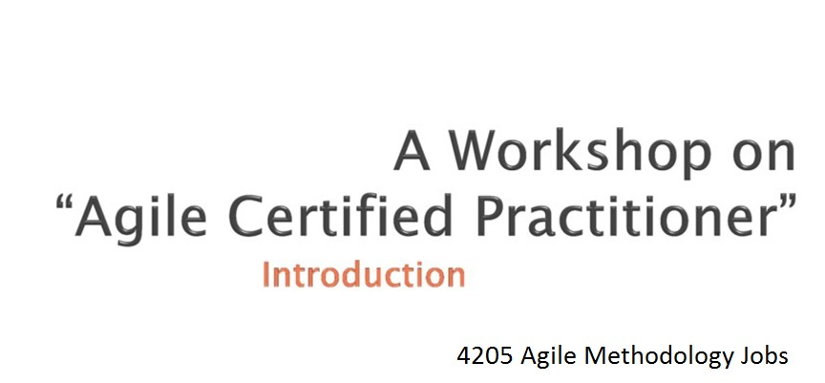
Copy rights reserved. @ 2013.

Slide 2
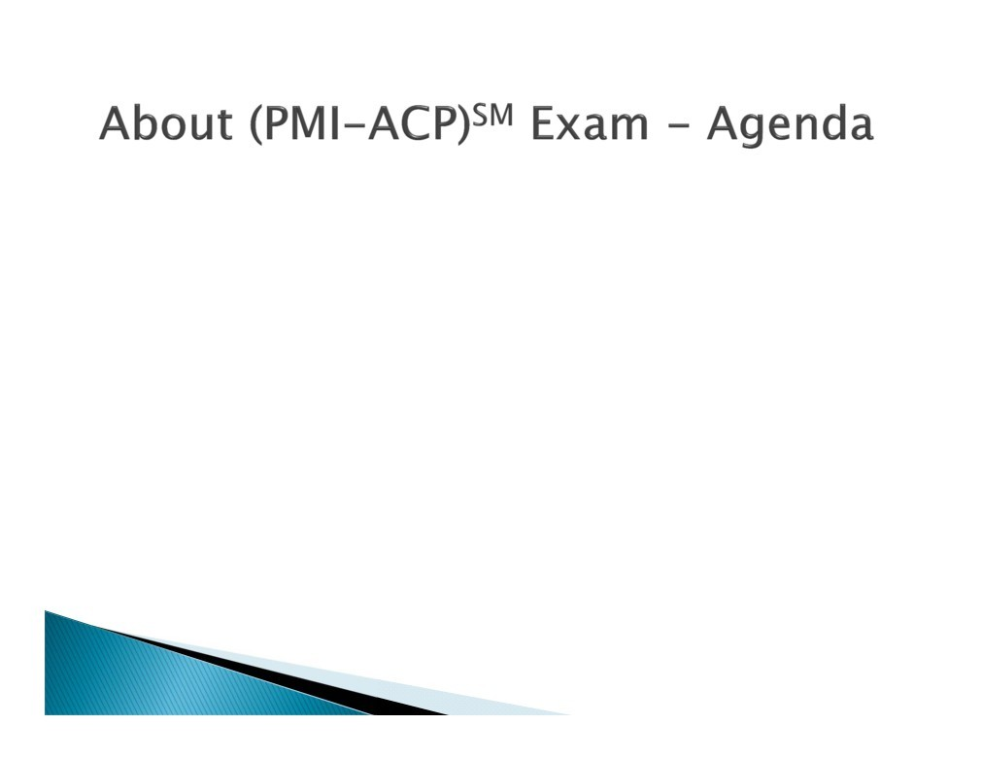
 Exam Eligibility
 Exam Pattern
 Pre requisites
 Content Distribution
 Tools and Techniques
 Domains and Tasks for Agile Certification
(PMI®-ACP) Agile Certified
Practitioner

Slide 3
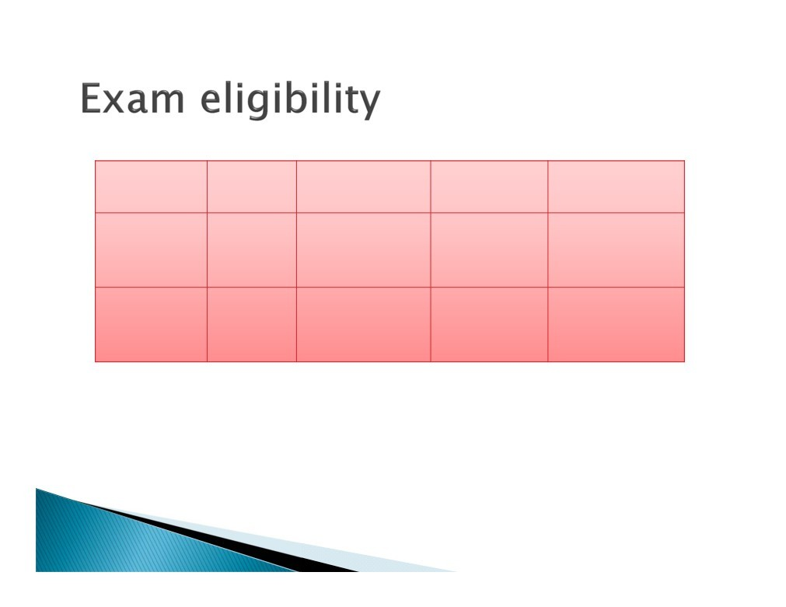
Category
Education
PM education
General PM Experience
Agile PM Experience
One
Bachelors
21 contact Hours
2000 hrs
1500 hrs
(Last 2 Years)
Two
High School
21 contact Hours
4000 hrs
1500 hrs
(Last 2 Years)
(PMI®-ACP) Agile Certified
Practitioner

Slide 4
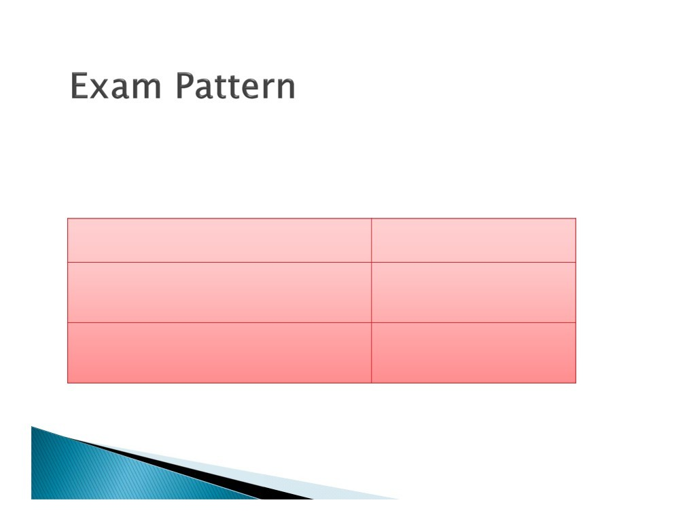
 No of Questions : 120
 Duration : 3 hours
Part
Agile Tools and Techniques
Agile Knowledge and Skills
Percentage
50%
50%
(PMI®-ACP) Agile Certified
Practitioner

Slide 5
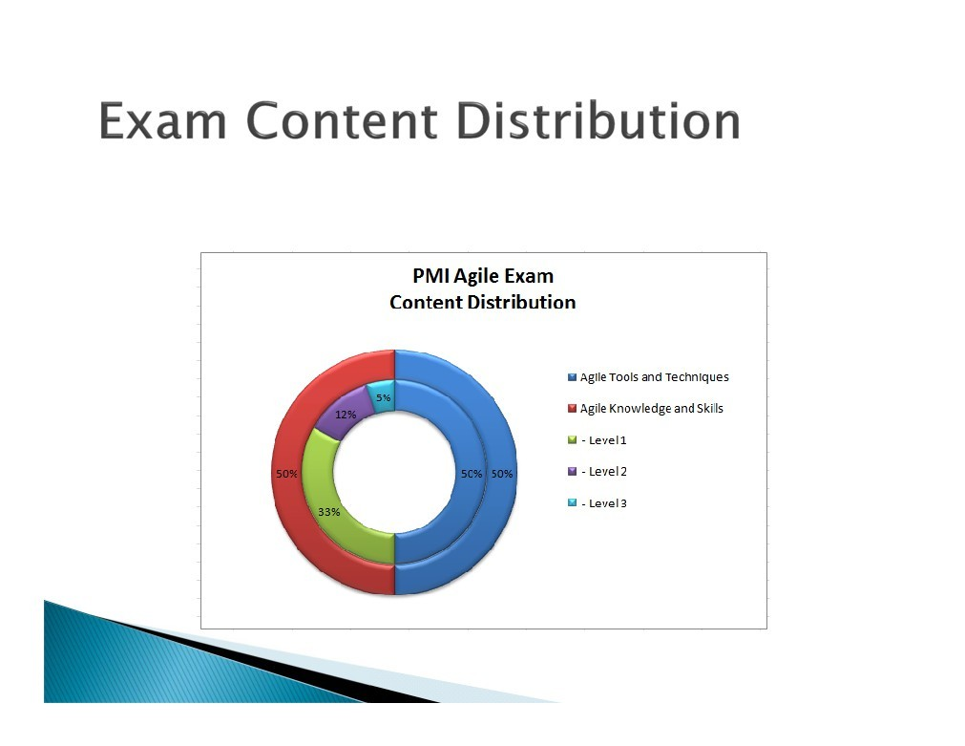
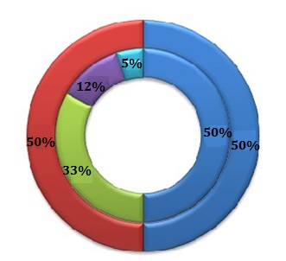
(PMI®-ACP) Agile Certified
Practitioner

Slide 6
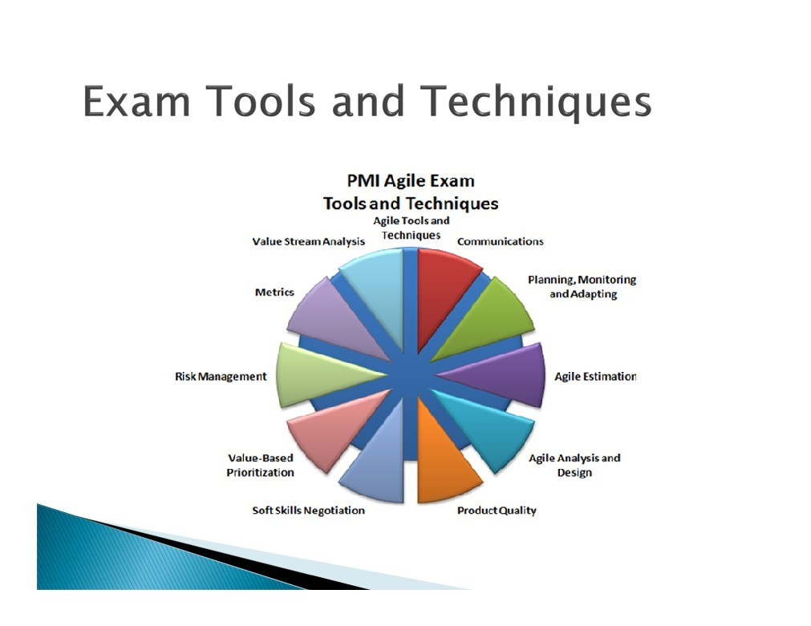
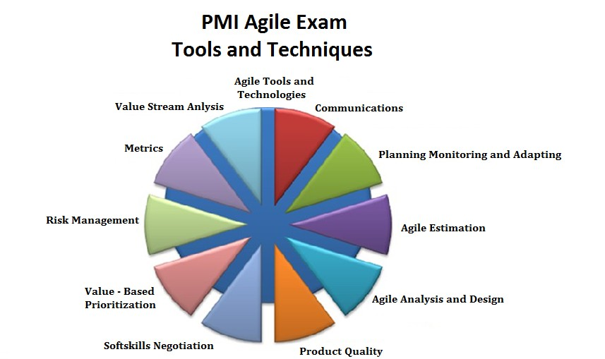
(PMI®-ACP) Agile Certified
Practitioner

Slide 7
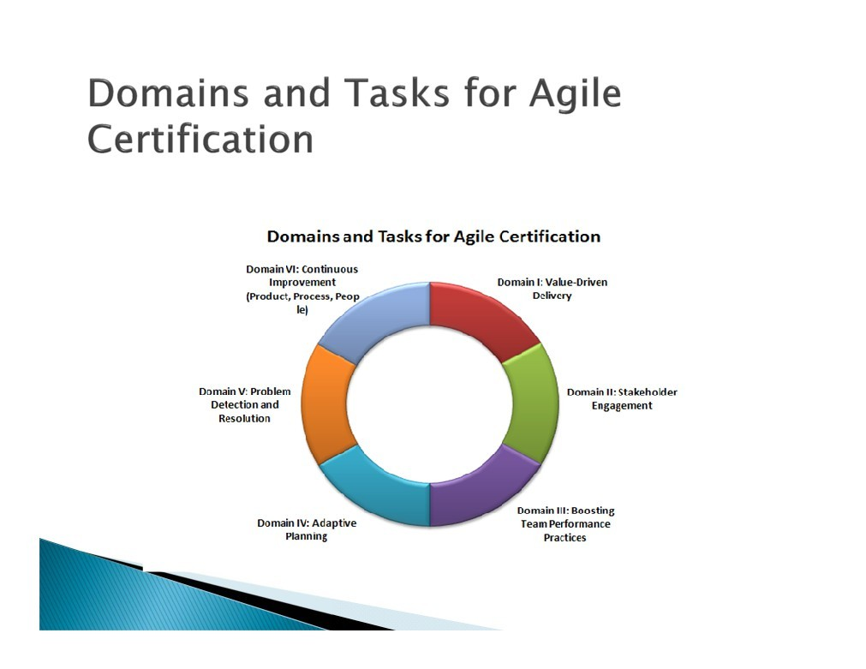

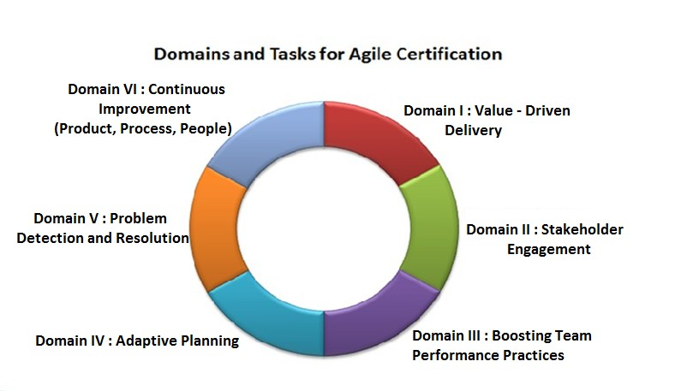
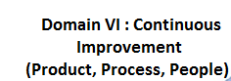
(PMI®-ACP) Agile Certified
Practitioner

Slide 8

“Fail early, fail often, revise & learn”

Slide 9
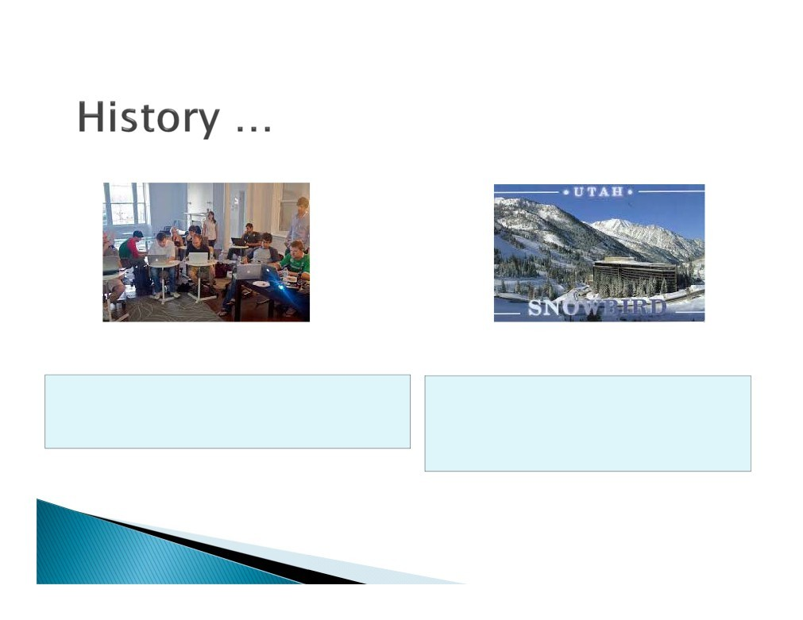
In February 2001, 17 software developers met to discuss lightweight development methods.
They published the Agile Manifesto for Software Development to define the approach now known as agile software development
(PMI®-ACP) Agile Certified
Practitioner

Slide 10
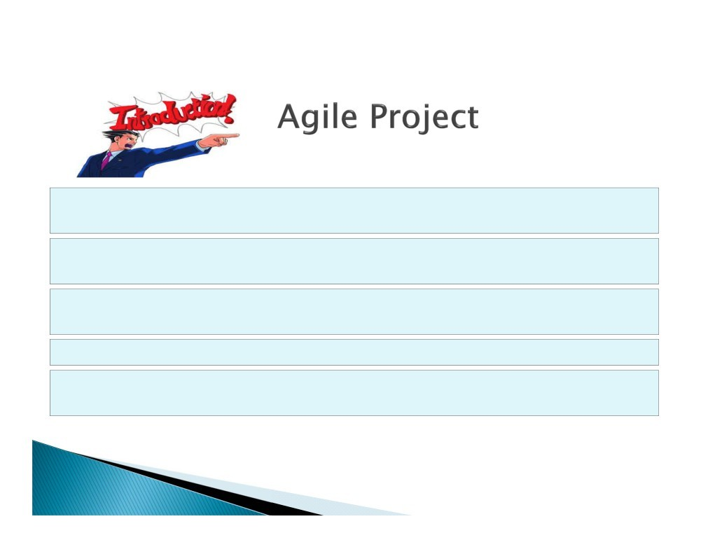
Group of software development methods based on Iterative and incremental
development
Requirements and solutions evolve through collaboration between self-organizing, Cross-functional teams
Promotes adaptive planning, evolutionary development and delivery. Time-boxed
iterative approach
Encourages rapid and flexible response to change
It is a conceptual framework that promotes foreseen interactions throughout the development cycle. The Agile Manifesto introduced the term in 2001.
(PMI®-ACP) Agile Certified
Practitioner

Slide 11
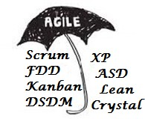
Lightweight agile software development methods evolved in the mid-1990s as a reaction against the Heavyweight waterfall-oriented methods.
1994
1995
1996
1997
RUP
Rationali Uniifed Process
Scrum, DSDM
Dynamic systems development method
Crystal Clear -light Weight Methodology
XP - Extreme programming
ASD - Adaptive software development
FDD - Feature-driven development
These are now collectively referred to as agile methodologies
(PMI®-ACP) Agile Certified
Practitioner

Slide 12
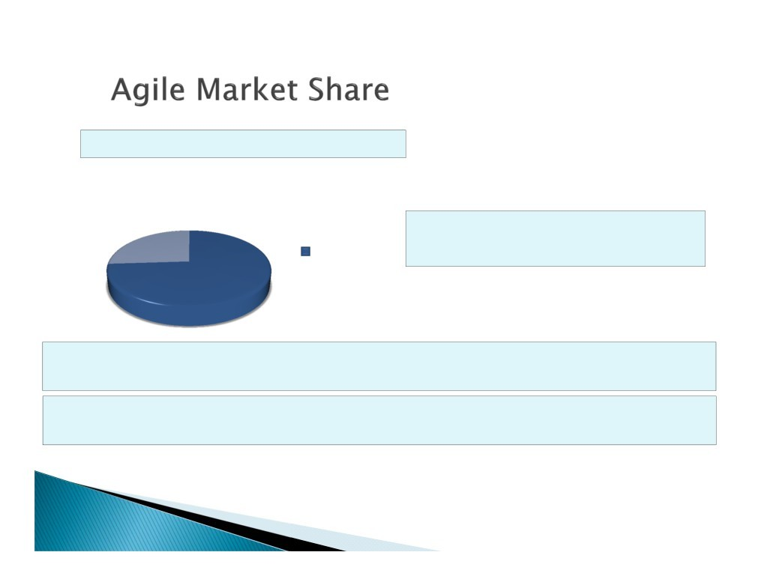
Survey Respondent
Agile practices are gaining in popularity
26%
Forrester Study shows 74% of respondents claim a mature adoption of agile (“How Agile is Your Organization?, April 30,2013)
Claim Mature Adoption
74%
Agile provides a great way for software development organizations to deliver quality software in a predictable fashion
Many organizations use a combination of agile and waterfall techniques depending on goals.
12

Slide 13
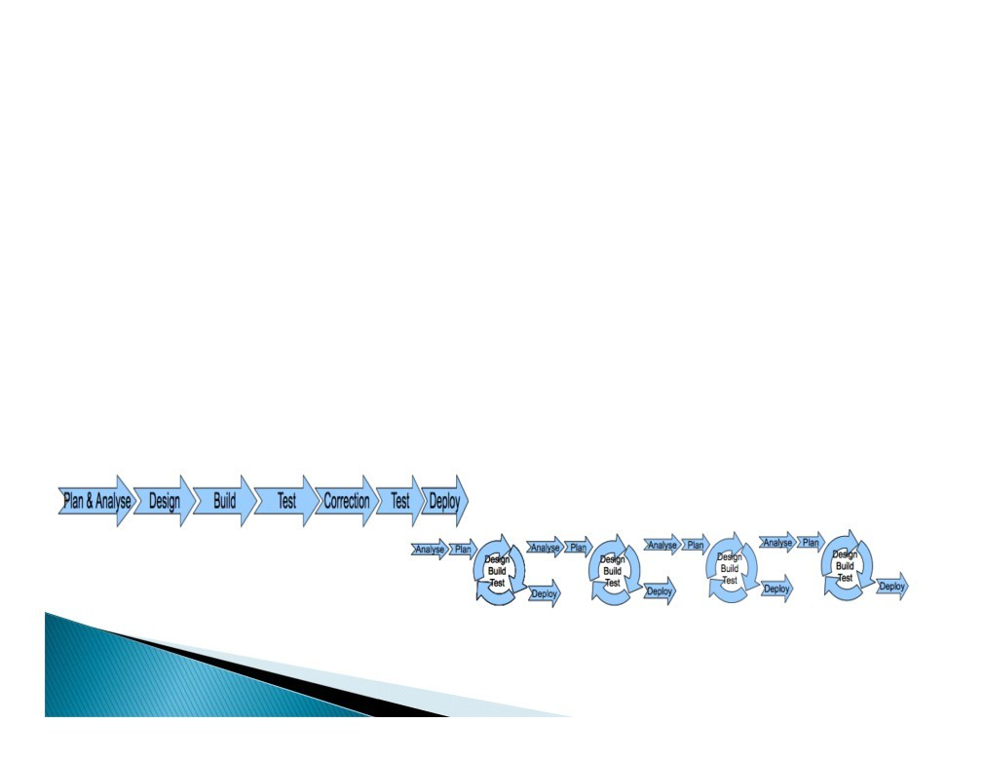
Traditional Software Development Agile Software Development
Requirements are analyzed Architecture and Design are created Requirements are implemented, tested and delivered
Months (or longer) occur before usable software for customer to evaluate
Requirements are translated into User Stories and become the product backlog
Usable chunks (high Value Stories) of software are developed in short periods of time (sprints, iterations, etc.)
Customer works with the team and reviews software regularly
Priorities may shift from iteration to iteration Agile teams expect and embrace change
14

Slide 14
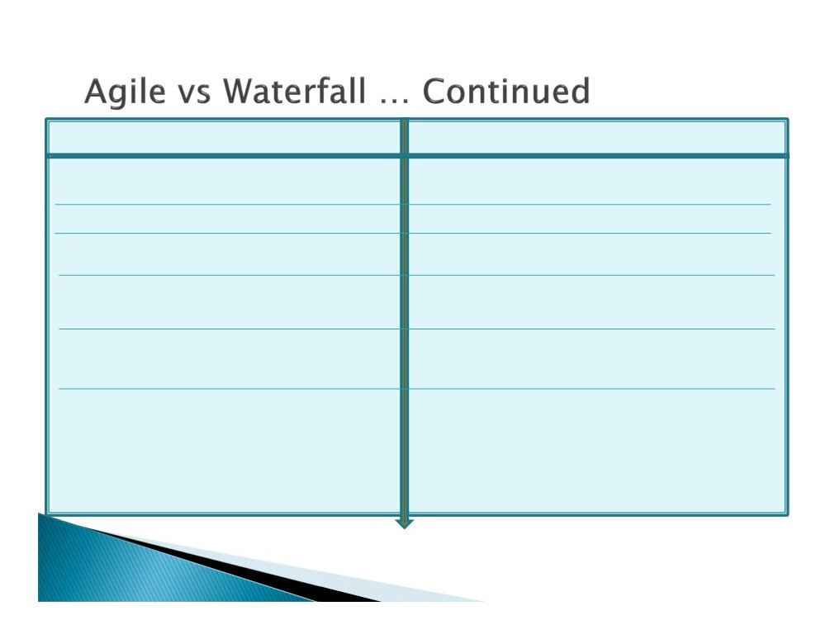
Traditional Project Management
Planning given importance
Scope is fixed. Time and cost are derived
Agile Project Management
Execution given importance than planning Time and cost are fixed. Scope is derived
Delivering within triple constraint is a
Delivering business value is the success of
success
the project
Scope once fixed follows change control
Scope is flexible and change is accommodative
Process and customer charged for every
change
Team controls the project and team is
Project manager controls the project and
self organizing to take care of the project
Controls the team
Documents are interim deliverables and
Incremental product is delivered to
Final product is delivered at the end of
Customer frequently
the phase
(PMI®-ACP) Agile Certified
Practitioner

Slide 15


Give me all requirements, otherwise it will cost you!
13

Slide 16
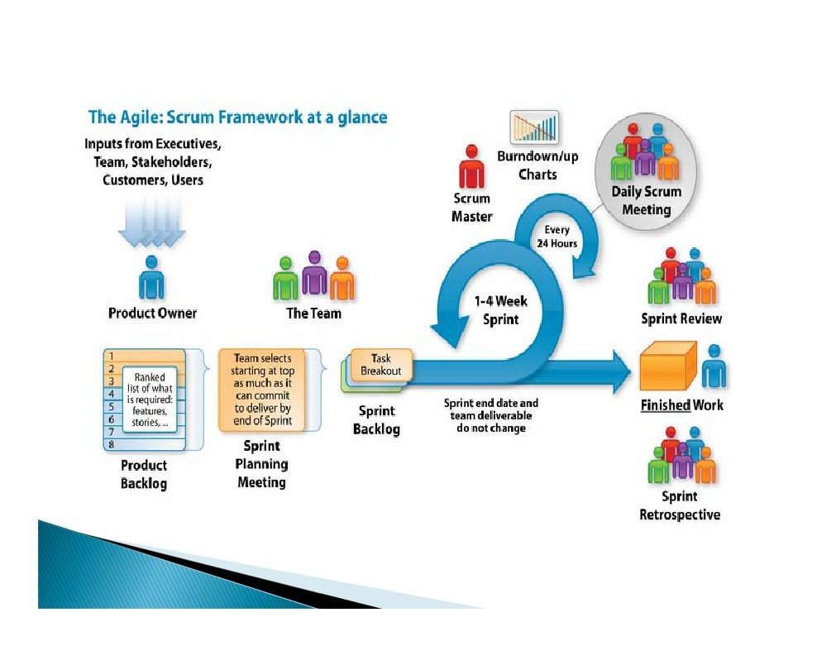
(PMI®-ACP) Agile Certified
Practitioner

Slide 17






_{Role}Scrum framework
Roles
Product owner
ScrumMaster
Team
Ceremonies
Sprint planning
Sprint review
Sprint retrospective
Daily scrum meeting
Artifacts
Product backlog
Sprint backlog
Burndown charts

Slide 18


_{Role}Scrum framework
Roles
Product owner
ScrumMaster
Team
Ceremonies
Sprint planning
Sprint review
Sprint retrospective
Daily scrum meeting
Artifacts
Product backlog
Sprint backlog
Burndown charts

Slide 19

Product owner
Define the features of the product
Decide on release date and content
Be responsible for the profitability of the product (ROI)
Prioritize features according to market value
Adjust features and priority every iteration, as needed
Accept or reject work results

Slide 20

The ScrumMaster
The Scrum Master is a servant-leader for the Scrum Team
Responsible for enacting Scrum values and practices
Removes impediments for the team
Ensure that the team is fully functional and productive
Enable close cooperation across all roles and functions
Shield the team from external interferences
Coaching the Development Team in self-organization and cross-functionality
Helping the Development Team to create high-value products
Ensures that the Product owner knows how to prioritize product backlog items

Slide 21





The Development team
Typically 3-9 people (excluding product owner and scrum master
Cross-functional:
Programmers, testers, user experience designers, etc.
No specific titles. Every member is a developer
Self Organizing
No External specialists
Members should be full-time
May be exceptions (e.g., database administrator)

Slide 22



_{Role}Scrum framework
Roles
Product owner
ScrumMaster
Team
Ceremonies
Sprint planning
Sprint review
Sprint retrospective
Daily scrum meeting
Artifacts
Product backlog
Sprint backlog
Burndown charts

Slide 23



























Sprint planning meeting
Team capacity
Sprint prioritization
Product backlog
Analyze and evaluate product backlog
Select sprint goal
Sprint goal
Business conditions
Sprint planning
Decide how to achieve sprint goal (design)
Create sprint backlog (tasks) from product backlog items (user stories
/ features)
Estimate sprint backlog in hours
Current product
Sprint backlog
Technology

Slide 24





Sprint planning
Team selects items from the product backlog they can commit to completing
Sprint backlog is created
Tasks are identified and each is estimated (1-16 hours)
Collaboratively, not done alone by the ScrumMaster
High-level design is considered
8 hours / month sprint
Definition of done agreed
The Product Owner can help to clarify the selected Product Backlog items and
make trade-offs
As a vacation
planner, I want to see photos of the hotels.
Code the middle tier (8 hours) Code the user interface (4) Write test fixtures (4)
Code the foo class (6) Update performance tests (4)

Slide 25
Definition of done
DoD is a checklist of acceptance criteria required to produce software
DoD can be agreed at different levels
Definition of Done for a feature (story or product backlog item)
Definition of Done for a sprint (collection of features developed within a sprint)
Definition of Done for a release (potentially shippable state)

Slide 26






The sprint goal
A short statement of what the work will be focused on during the sprint
Life Sciences
Support features necessary for population genetics studies.
Database Application
Make the application run on SQL Server in addition to Oracle.
Financial services
Support more technical indicators than company ABC with real-time, streaming data.

Slide 27
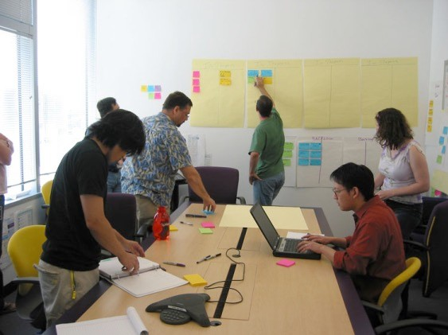
The daily scrum
Parameters
Daily
15-minutes
Stand-up
Not for problem solving
Whole world is invited
Only team members, ScrumMaster, product owner, can talk
Helps avoid other unnecessary meetings

Slide 28
















Everyone answers 3questions
1
What did you do yesterday?
2
What will you do today?
3
Is anything in your way?
These are not status for the ScrumMaster
– They are commitments in front of peers

Slide 29
The sprint review
Team presents what it accomplished during the sprint
Typically takes the form of a demo of new features or underlying architecture
Whole team participate
4 hours/month sprint
Attendees include the Scrum Team and key stakeholders invited by the Product Owner;
The Product Owner explains what Product Backlog items have been “Done” and what has not been “Done”;
The Development Team discusses what went well during the Sprint, what problems it ran into, and how those problems were solved;
The Development Team demonstrates the work that it has “Done” and answers questions about the Increment;

Slide 30
Sprint retrospective
Periodically take a look at what is and is not working
3 hours/
Done after every sprint
Whole team participates
ScrumMaster
Team
Possibly Product owner

Slide 31










Start / Stop / Continue
Whole team gathers and discusses what they’d like to:
Start doing
Stop doing
This is just one
of many ways to
Continue doing
do a sprint retrospective.

Slide 32
Scrum framework
Roles
Product owner
ScrumMaster
Team
Ceremonies
Sprint planning
Sprint review
Sprint retrospective
Daily scrum meeting
Artifacts
Product backlog
Sprint backlog
Burndown charts

Slide 33




Product backlog
The requirements
A list of all desired work on the project
Ideally expressed such that each item has value to the users or customers of the product
Prioritized by the product owner
Reprioritized at the start of each sprint
This is the product backlog

Slide 34
A sample product backlog
Backlog item | Estimate
Allow a guest to make a reservation | 3
As a guest, I want to cancel a reservation. | 5
As a guest, I want to change the dates of a reservation. | 3
As a hotel employee, I can run RevPAR reports (revenue-per-available-room) | 8
Improve exception handling | 8
... | 30
... | 50

Slide 35
Managing the sprint backlog
Individuals sign up for work of their own choosing
– Work is never assigned
Estimated work remaining is updated daily
Any team member can add, delete or change the sprint backlog
Work for the sprint emerges
If work is unclear, define a sprint backlog item with a larger amount of time and break it down later
Update work remaining as more becomes known

Slide 36












A sprint backlog
Tasks | Mon | Tues | Wed | Thur | Fri
Code the user interface | 8 | 4 | 8
Code the middle tier | 16 | 12 | 10 | 4
Test the middle tier | 8 | 16 | 16 | 11 | 8
Write online help | 12
Write the foo class | 8 | 8 | 8 | 8 | 8
Add error logging |  |  | 8 | 4

Slide 37
Sprint
A sprint (or iteration) is the basic unit of development in Scrum. The sprint is a timeboxed effort; that is, it is restricted to a specific duration. The duration is fixed in advance for each sprint and is normally between one week and one month, with two weeks being the most common
Sprint represents one developmental lifecycle

Slide 38





Project Objective
Business Case
Project Charter
Product Roadmap
Product Backlog
Releases
Release 1 | Release 2 | Release 3 | Release 4
Iterations
I1 | I2 | I3 | I4 | I5 | I6 | I7 | I8 | I9 | I10 | I11 | I12

Slide 39
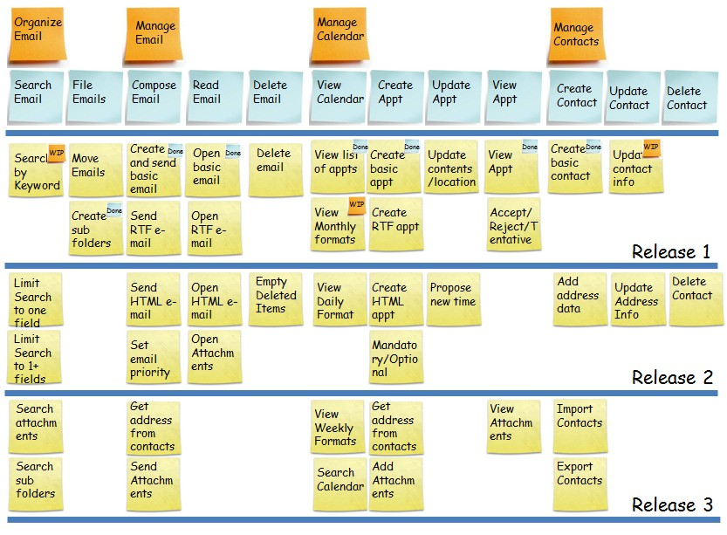

Story Maps/Themes

Slide 40
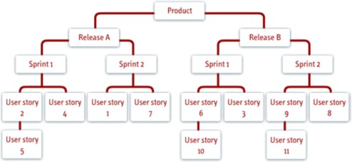
Agile Project Management Snapshot

Slide 41













Product Road Map
25th Aug 15
2nd Distributed Game – Brickyard (Multi User)
A product roadmap shows how the product will evolve over the next three to four releases or some period of calendar time, typically quarters. It’s a high-level representation of what features or themes are to be delivered in each release
18th Jul 15
First Distributed Game – Road Rage (Multi User)
22nd May 15
First Two Game available –
Road Rage & Brickyard (Single
User)
10th May 15
Game1 Demo –
Proof of Viability on new
platform

Slide 42
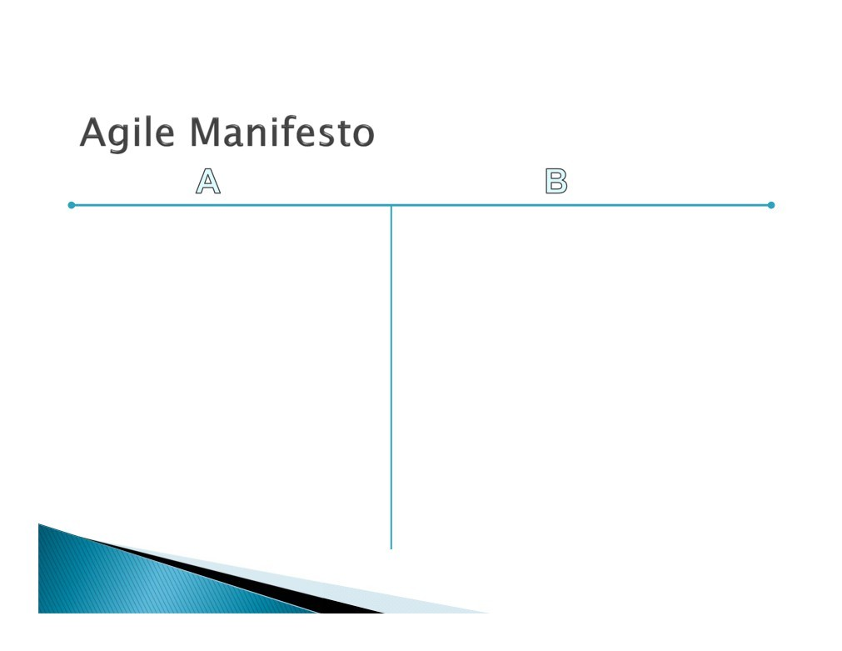
Individuals and interactions | over | processes and tools
Working software | over | comprehensive documentation
Customer collaboration | over | contract negotiation
Responding to change | over | following a plan
That is, while there is value in the items on the right, we value the items on the left more.
(PMI®-ACP) Agile Certified
Practitioner

Slide 43
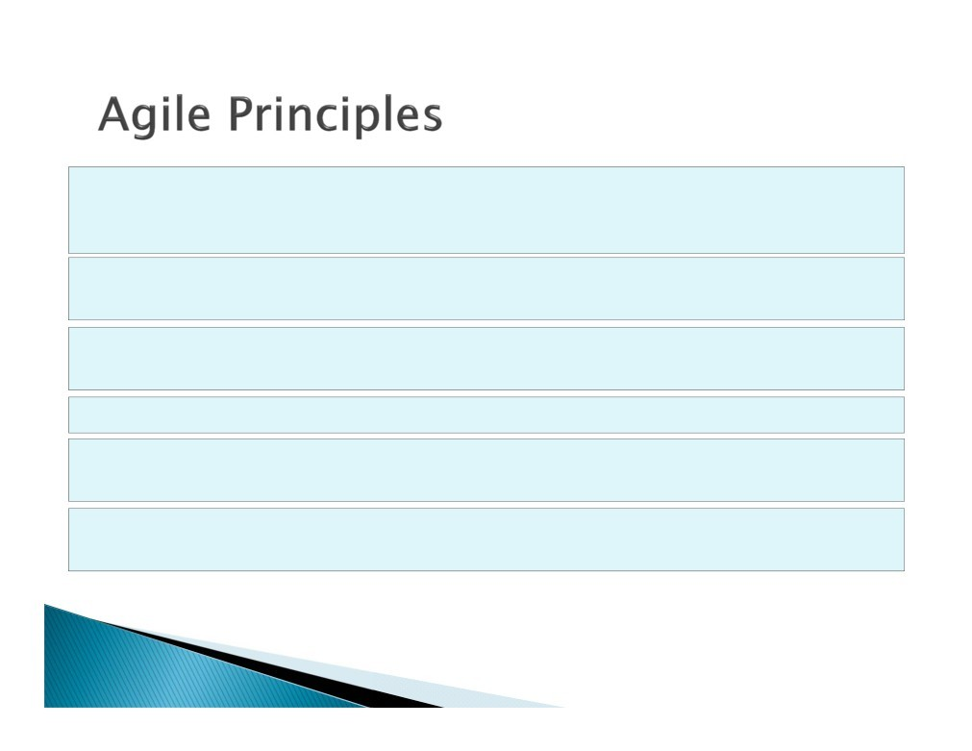
Our highest priority is to satisfy the customer through early and continuous delivery of valuable software
Welcome changing requirements, even late in development. Agile processes harness change for the customer’s competitive advantage
Deliver working software frequently, from a couple of weeks to a couple of months, with a preference to the shorter timescale
Business people and developers must work together daily throughout the project
Build projects around motivated individuals. Give them the environment and support they need, and trust them to get the job done.
The most efficient and effective method of conveying information to and within a development team is face-to-face conversation.
(PMI®-ACP) Agile Certified
Practitioner

Slide 44
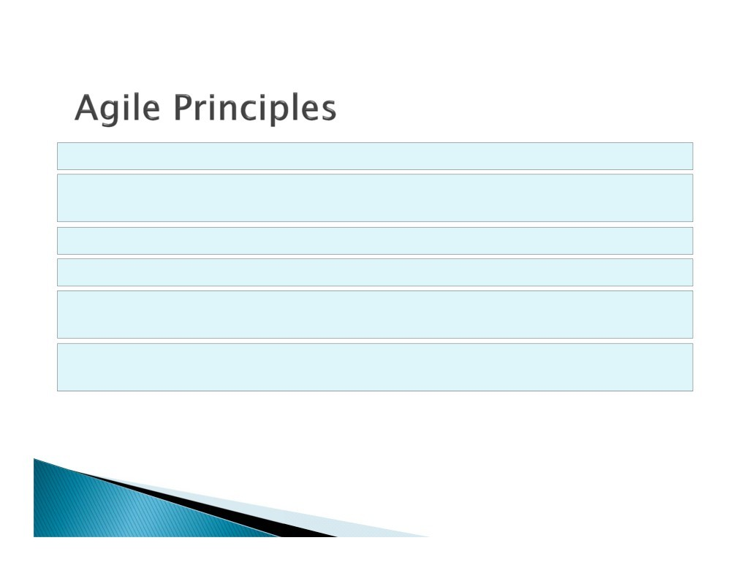
Working software is the primary measure of progress.
Agile processes promote sustainable development. The sponsors, developers, and users should be able to maintain a constant pace indefinitely.
Continuous attention to technical excellence and good design enhances agility.
Simplicity - the art of maximizing the amount of work not done is essential.
The best architectures, requirements, and designs emerge from self-organizing teams.
At regular intervals, the team reflects on how to become more effective, then tunes and adjusts its behavior accordingly.
(PMI®-ACP) Agile Certified
Practitioner

Slide 45
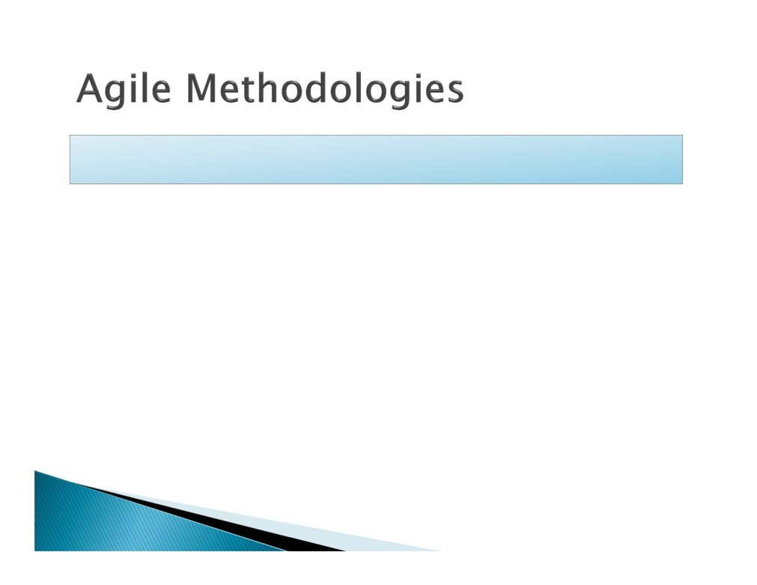
 These are frameworks and processes which are based on Agile manifesto and principles.
 XP
 DSDM
 Scrum
 AUP
 Agile Modeling
 Agile Data Method
 Essential Unified Process
 FDD
 Open UP
 Lean software Development
 Crystal Methods
(PMI®-ACP) Agile Certified
Practitioner

Slide 46
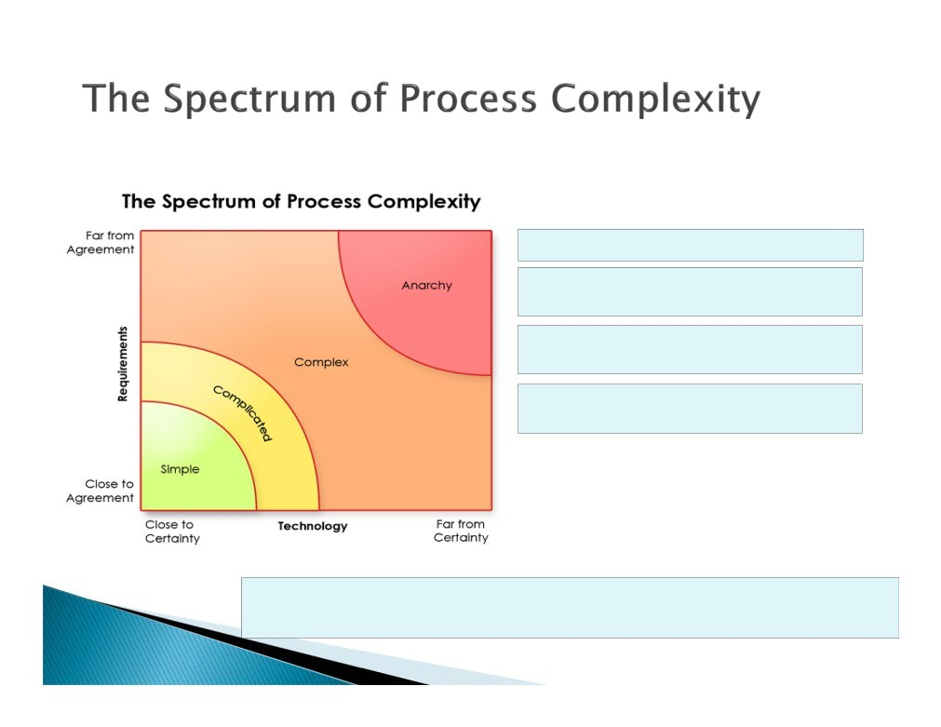
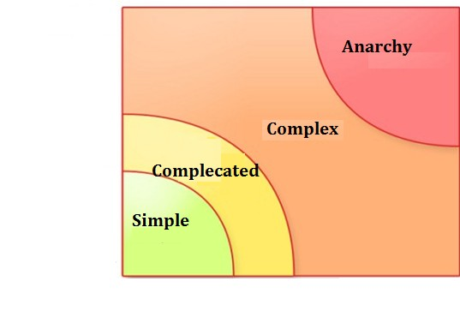
Far from Agreement
Simple = easily knowable.
Complicated = not simple, but still knowable
Complex = not fully knowable, but reasonably predictable.
Chaotic = neither knowable nor predictable
Requirements
Close to Agreement
Close to Certainty
Technology Far from Certainty
When you manage a system, you need to know whether it is either predictable or complex.
If you take the wrong approach to building or managing such a system,
you’re either blow-drying your pizza, or microwaving your dog
(PMI®-ACP) Agile Certified
Practitioner

Slide 47
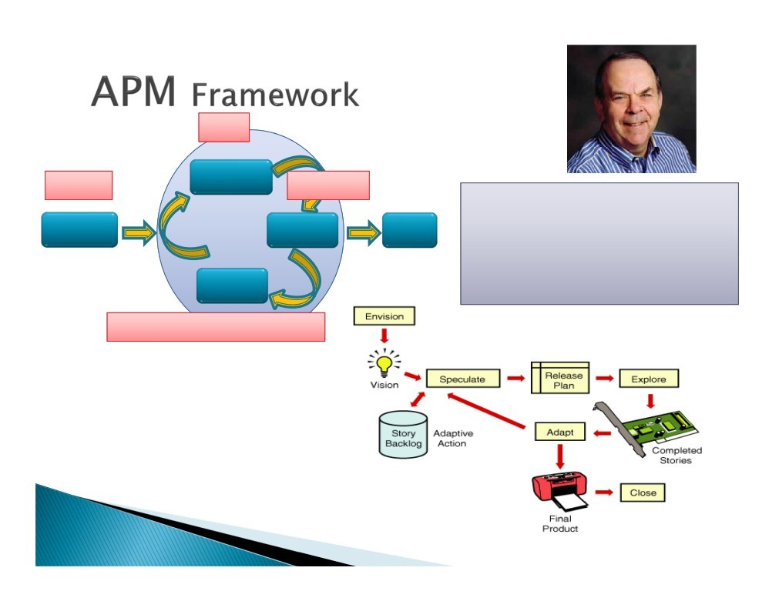
Plan
Initiate
Envision
Speculate
Execute
Explore
Mr. Jim Highsmith
Coauthor : Agile Manifesto, Declaration of Interdependence for project leaders Author: Adaptive Software Dev. (Jolt Award 2000), APM Framework
Founding Member : Agile Alliance, Agile Project Leadership Network
Current: Director of “Cutter Consortium”
Close
Adapt
Monitoring and Control
(PMI®-ACP) Agile Certified Practitioner

Slide 48

Our First Product: Paper Airplanes
How good can your team get at making paper airplanes?
Acceptance Criteria
Airplane is made from ¼
sheet of A4 paper
Airplane has wings
Airplane has a blunt tip
Airplane can fly 3m on the first attempt
Definition of “Done”
Airplane meets all the acceptance criteria
Airplane has passed all tests successfully
Airplanes are only allowed to fly in the test area
Only one fold per person at a time. (After 1 fold, you must pass the airplane to someone else on your team.)
48

Slide 49

(PMI®-ACP) Agile Certified Practitioner

Slide 50
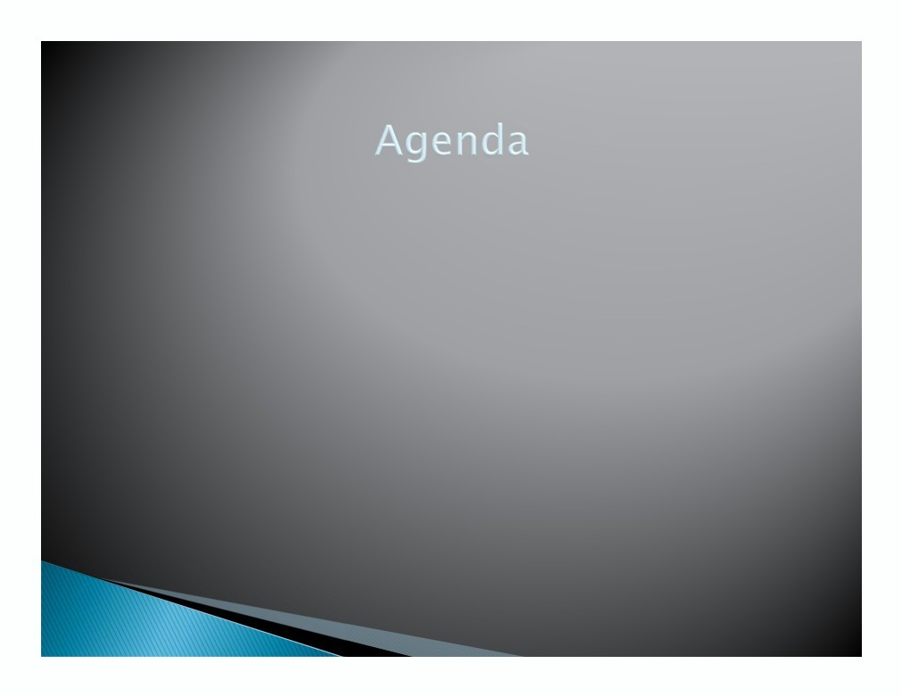
 Envision
 APM Framework (Envision)
 Things to Know
Objectives
Activities
 Requirement Gathering
 Organize Features
 Accounting Risk
(PMI®-ACP) Agile Certified
Practitioner

